Slide 1
Our FDC: a Child Safe Organisation
This resource has been provided by the Department of Education as part of the Early Childhood Education and Care Sector Development Program.
Notes:
This PowerPoint presentation is designed to talk to you about child safety. Our organisation is committed to ensuring our organisation is child safe.
What is child safety? Is it child protection? Yes and no. Our organisation is a child safe organisation because we are committed to ensuring children are safe when we care for them. Within our service.

Slide 2
Children should be safe
All children have the right to feel safe and to be safe all of the time.
All children who are cared for by our service should always feel safe at the service.
Notes:
All children have the right to feel safe and to be safe all of the time.
All children who are cared for by our service should always feel safe at the service.
This may seem obvious – after all we do a lot of things at our FDC to ensure children are safe at all times. This is about making sure that children are not subject to harm while we are caring for them.
[Ask the group to think about recent public examples where children have been harmed by organisations and the people within them. The sorts of answers are schools and churches that have been the focus of attention of the Royal Commission into Institutional Responses to Child Sexual Abuse, recent cases also include a dance school in Sydney, an Out of School Hours Care service in Sydney etc.]
Children can get harmed in organisations like ours because sometimes adults who do not have the best interests of children at heart deliberately try and become involved in organisations that care for children or be situational – where an adult harms a child because they are in a situation where they can.

Slide 3
We are a child safe organisation
We want to keep children safe in our FDC service
We do this by having:
a child safe policy
a code of conduct
a complaints policy
effective recruitment
training for educators and staff
Notes:
We want to keep children safe in our FDC service
We do this by having:
a child safe policy [give an overview of the policy]
a code of conduct [hand out the code and discuss]
a complaints policy [discuss]
effective recruitment [discuss what you do at recruitment eg WWCC/ reference checks etc]
training for educators and staff [like this]

Slide 4
What is acceptable behavior for adults in our service?
Notes:
[Brain storm what is and what isn’t acceptable behaviour for adults with children in the service – base this on your code of conduct ]
When unacceptable behaviour is engaged in, children can be subject to:
physical,
sexual,
emotional or
psychological harm.

Slide 5
We have a code of conduct
A code of conduct helps protect children from harm and demonstrates our service’s commitment to being a child safe organisation.
As an educator you MUST follow the code.
If you don’t there will be consequences.
Notes:
[Hand out the service’s code of conduct – work though every item in it. Explain that it has behaviours on it that we do at our service and behaviours that we don’t do. Make sure that everyone is aware of the difference. Use scenarios – would these fall into the do or don’t categories?
Individual scenarios could include:
Having a child sit on your lap while you tell a story. Always having the same child on your lap when you tell stories. Having a child on your lap while all the other children are running in the back yard.
Helping a child go to the toilet. Is this appropriate for a 2 year old? For an 8 year old?
Leaving a child alone with a visitor to your home? Leaving a child alone with a FDC Co-ordinator? ]
Non-compliance with the code will force our service to take disciplinary action against an educator – including terminating their services.

Slide 6
Safety is complex
A child is not safe if their identity is overlooked or misunderstood.
You cannot show dislike, ridicule or ignore a child’s cultural or religious background.
Notes:
The focus of a child-safe organisation is not simply to create an environment that minimises risk or danger. It is about building an environment which is both child safe and child-friendly, where children feel and are respected, valued and encouraged to reach their full potential. The experiences of children from culturally diverse backgrounds are shaped by their encounters with Australian society including your FDC service – this can have significant effects on a child’s sense of inclusion and therefore safety. Likewise for children with additional needs.
When a child’s identity is overlooked, misunderstood or denigrated, they are also not being kept safe. When a child with additional needs cannot fully participate in your FDC service they are also not being kept safe.
Any conduct (whether deliberate or unknowingly performed) demonstrates dislike , ridicule or ignorance of a child’s cultural or religious background they are at risk of harm. A child’s sense of identity can be harmed by behaviour by an educator or staff member.

Slide 7
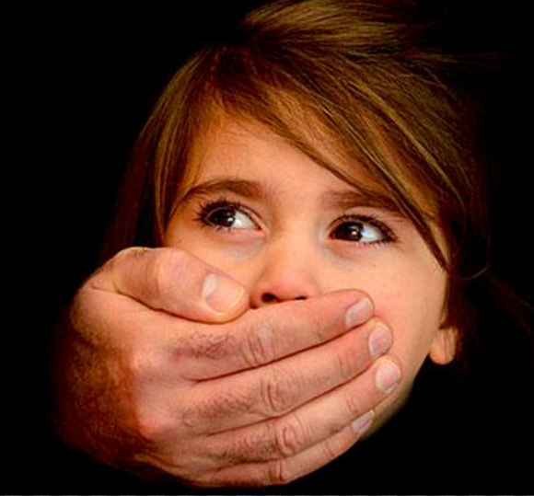
If you feel a child is not safe
You need to act!
Notes:
By now, you should be clear that all children at our service have the right to be free of physical, sexual, emotional or psychological harm or harm caused by racial, cultural, religious discrimination or lack of cultural sensitivity while being cared for by our service.
What can you do if you feel a child is not safe? [Brainstorm possible actions]
[Then take people through the actions required in the child safe policy and the code of conduct. Try and use actual scenarios]

Slide 8
We have a child safety officer
If you have concerns about the safety of a child being cared for in your home or another educator’s home you need to talk about it with our child safety officer.
Notes:
[tell everybody who the child safety officer is]
Having a specific person appointed to be the child safety person means that someone is charged with viewing our FDC from a child safety perspective.
If all other systems break down someone with concerns has a specific person you can seek out. This person can also become our organisation’s expert on issues such as mandatory reporting and reportable conduct.

Slide 9
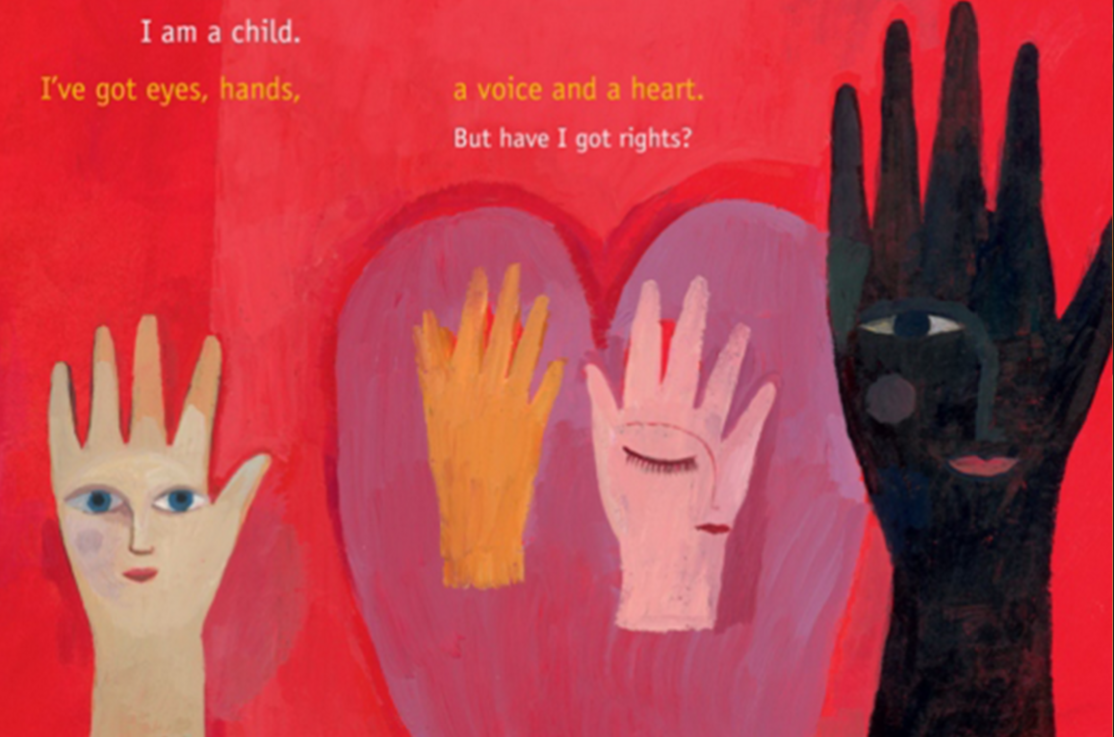
Children need to know their rights
Educating children about their rights and protective behaviours is another way you can help our FDC be child safe.
Notes:
Educating children about their rights and protective behaviours is another way we can help our FDC be child safe
[discuss ways that this can be done within normal programming].

Slide 10
Remember, keeping children safe is everyone’s responsibility
Notes:
Keeping children safe in our FDC is the responsibility of all of us. We hope you take it on as your responsibility, because all children deserve to be safe at our FDC always.

